Slide 1
Chapter 3.5
MATH 1550 Precalculus

Slide 2
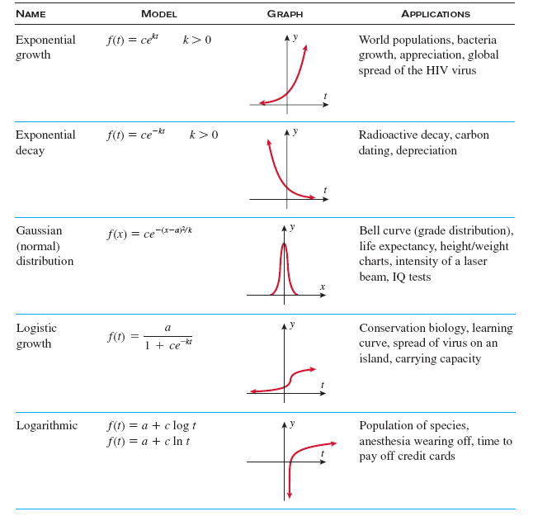
Common Exponential and Logarithmic Models
Exponential Growth
Exponential Decay

Slide 3
Common Exponential and Logarithmic Models
Gaussian Distribution
Logistic

Slide 4
Common Exponential and Logarithmic Models
Logarithmic

Slide 5
Exponential Growth Models
The combined population of North America was 300 million in 1995, and 332 million in 2005. Find the annual growth rate to the nearest percent, and use the growth rate to project when the North American population will reach 1 billion.

Slide 6
Exponential Growth Models
The population of a certain country was 3.2 million in 1998 and 3.5 million in 2001. In what year will the population have doubled since 1998?
In what year will the population have tripled?

Slide 7
Exponential Decay Models
A radioactive isotope used for medical imaging is known to have a half-life of 36 hours.
Determine the exponential decay model that represents the mass of the isotope.
If 1000 mg were administered, how many remain in the body after 48 hours?
How long does it take the original 1000 mg dose to decay to 100 mg?

Slide 8
Exponential Decay Models
The half-life of ²³⁸U (uranium-238) is 4.5 billion years. If 98% of uranium-238 remains in a fossil, how old is the fossil?

Slide 9
Exponential Decay Models
The isotope ²²²Ra has a half-life of 3.8 days.
Determine the exponential decay model that represents the mass of Radon-222.
How much of a 64-gram samples of radon-222 will remain after 7 days? Round to the nearest gram.
How long will it take for the original 64 gram sample to decay to a mass of 4 grams. Round to the nearest day.

Slide 10
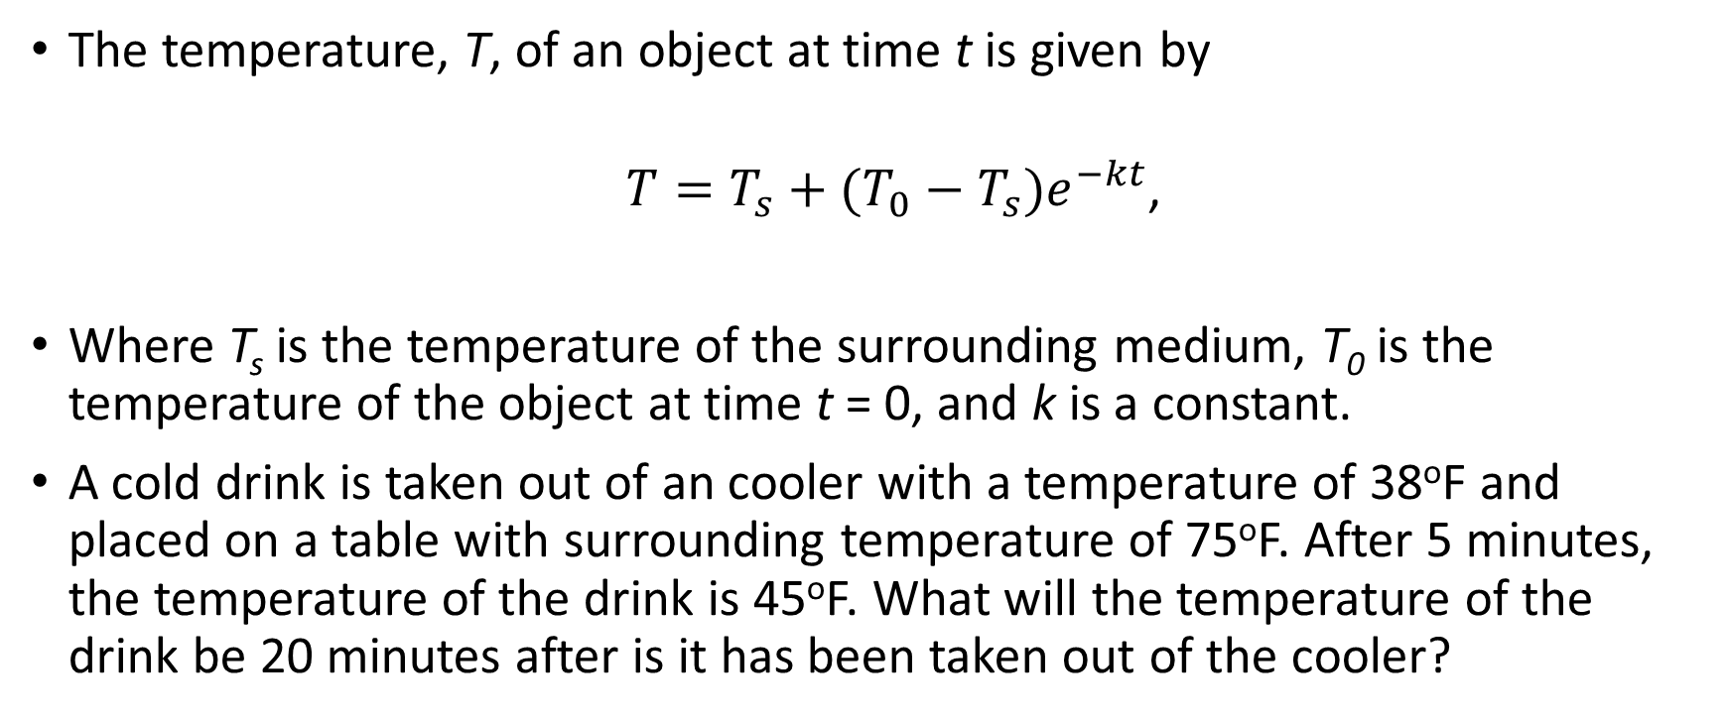
Newton’s Law of Cooling
The temperature, T, of an object at time t is given by
${T=T}_{s}+(T_{0}−T_{s})e^{−kt}$,
Where T_{s} is the temperature of the surrounding medium, T₀ is the temperature of the object at time t = 0, and k is a constant.
A cold drink is taken out of an cooler with a temperature of 38ºF and placed on a table with surrounding temperature of 75ºF. After 5 minutes, the temperature of the drink is 45ºF. What will the temperature of the drink be 20 minutes after is it has been taken out of the cooler?

